Slide 1
Optimizing Sales Strategies
Pens and Printers

Slide 2
Project Goals
Identify the most effective sales method to maximize revenue while optimizing resource allocation.
Analyze revenue trends and regional performance to refine marketing and sales strategies.
Establish a key business metric for ongoing performance tracking.
Provide data-driven recommendations to improve sales efficiency and future marketing strategies.

Slide 3
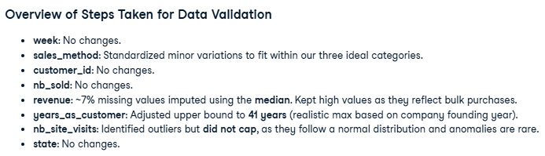
Data Validation

Slide 4
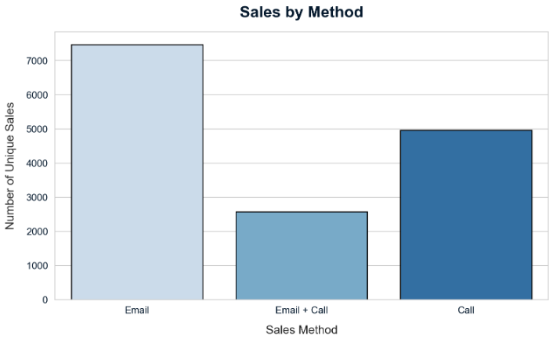
Observations
Data provided suggests sales contribution from different strategies as follows:
Email 50%
Call 33%
Email + Call 17%

Slide 5
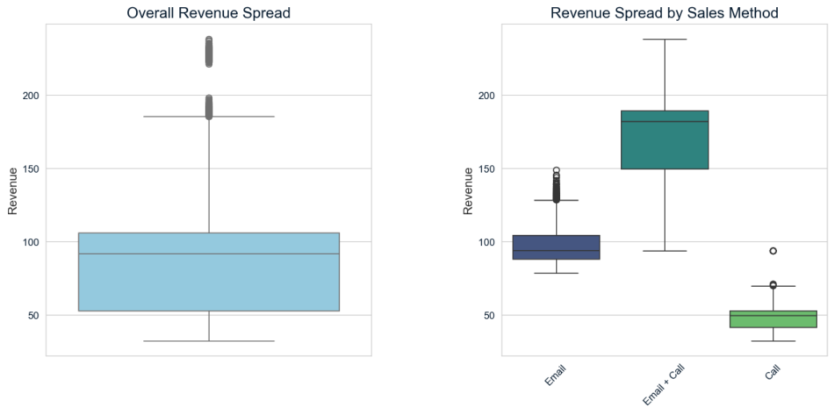
Observations

Slide 6
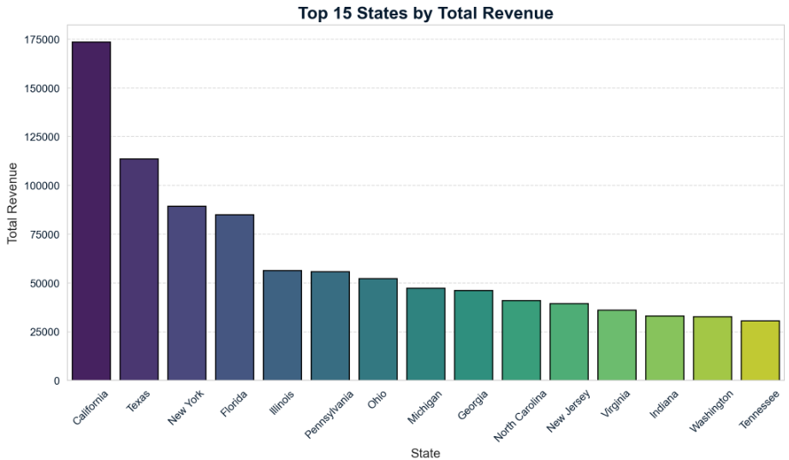
Key Findings
Top 7 states contribute 67% of total revenue. Namely:
California
Texas
New York
Floria
Illinois
Pennsylvania
Ohio

Slide 7
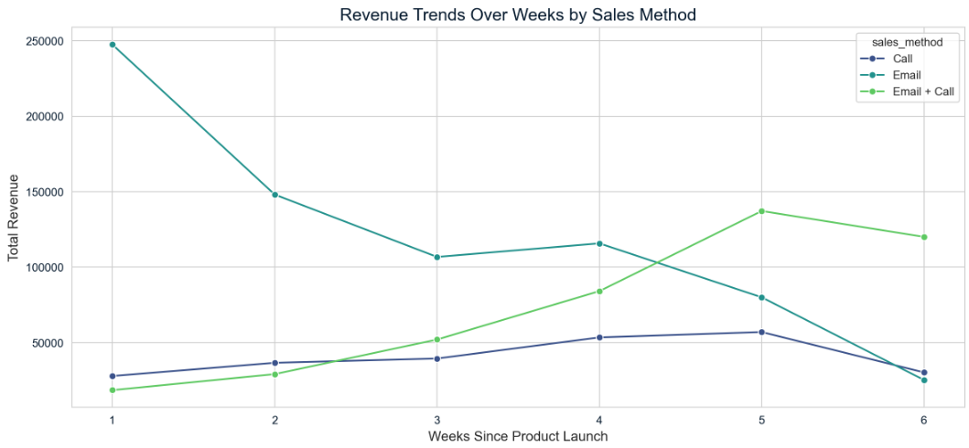
Key Findings

Slide 8
Business Metric Revenue per customer for each sale strategy
Email + Call
$171
Email
Call
$49
$97

Slide 9
Recommendations
Expand the email + call approach for high-value customers to maximize revenue.
Refine email-only campaigns by optimizing content, timing, and personalization.
Focus on top-performing states with targeted marketing efforts to drive higher returns. New strategies for other states to grow base revenue.
Reduce reliance on call-only sales, as they yield the lowest revenue per customer.
Continuously monitor revenue per customer trends to refine sales strategies based on performance insights.

